Slide 1
Pdf data extractor
SNEHA KOTHI

Slide 2
What IS PDF DATA EXTRACTOR ?
Companies require to extract the total amount from invoices to store into database or for further analysis and manually extracting data is non-profitable and exhausting.
Hence I have come up with a fully automated and deployed solution that decreases the time taken by extracting the total amount of the invoice from the pdf and storing it in a text file.

Slide 3
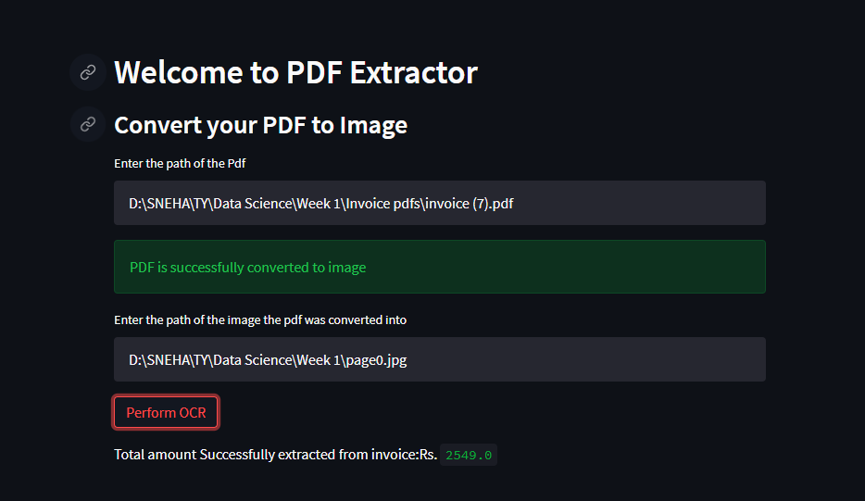
How does it work

